Slide 1
Digital Portfolio
STUDENT NAME: Bavidha
REGISTER NO AND NMID: 24131061805222005/D0068345CEAC9028D7B4BE5AD94A3117
DEPARTMENT:BACHELOR OF SCIENCE,DATA SCIENCE
COLLEGE/ UNIVERSITY:SHREE RAGHAVENDRA ARTS AND SCIENCE COLLEGE

Slide 2
PROJECT TITLE:
PORTFOLIO WEBPAGE

Slide 3
AGENDA
Problem Statement
Project Overview
End Users
Tools and Technologies
Portfolio design and Layout
Features and Functionality
Results and Screenshots
Conclusion
Github Link

Slide 4
PROBLEM STATEMENT :
A traditional resume cannot fully showcase a developer’s skills and projects. To solve this, a responsive personal portfolio website is needed to highlight profile details, projects, and contact information in one place.

Slide 5
PROJECT OVERVIEW :
This project is a personal portfolio website built with HTML, CSS, and JavaScript to showcase profile details, projects, and contact information in a clean and responsive design.

Slide 6
WHO ARE THE END USERS?
recruiters, clients, and peers

Slide 7
TOOLS AND TECHNIQUES
* HTML
* CSS
* JAVASCRIPT
* VS CODE

Slide 8
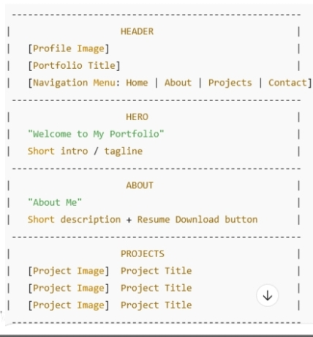
POTFOLIO DESIGN AND LAYOUT

Slide 9
FEATURES AND FUNCTIONALITY
Profile Section: Displays a profile image and introduction.
Navigation Menu: Easy access to Home, About, Projects, and Contact sections.
Hero Section: A welcoming highlight with a brief introduction.
About Section: Provides background information and resume download option.
Projects Section: Showcases project images with titles for quick viewing.
Contact Form: Allows users to send messages with instant acknowledgment.
Responsive Design: Ensures the website adapts to desktops, tablets, and mobile devices.
Interactive UI: Hover effects and form handling improve user experience.

Slide 10
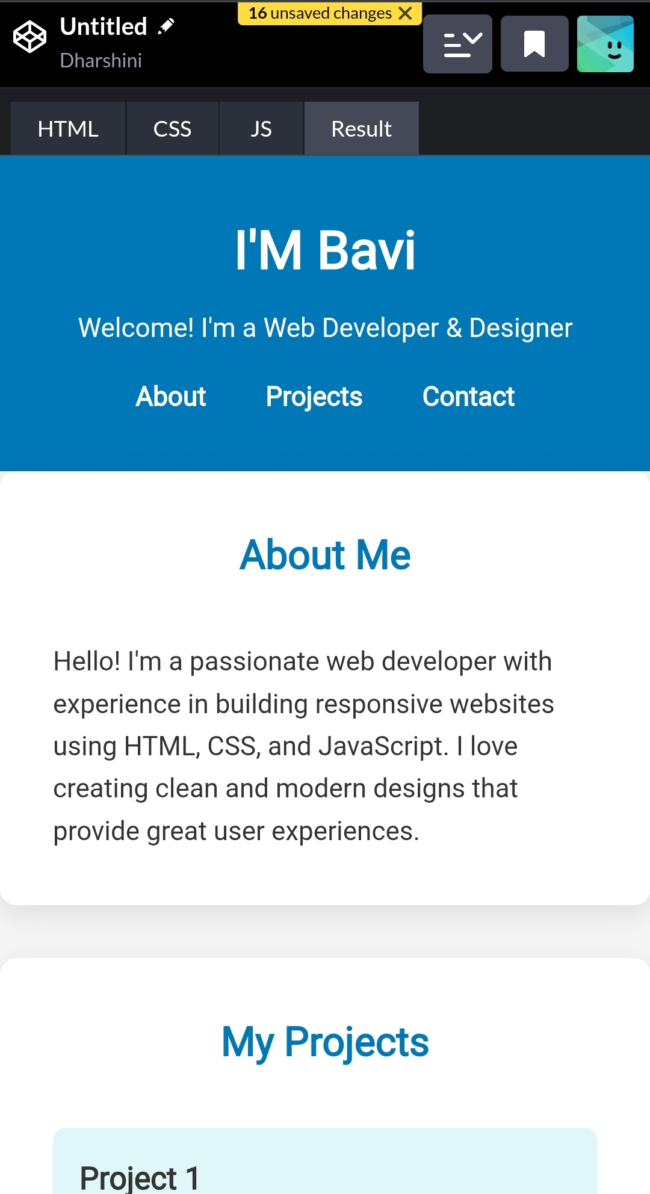
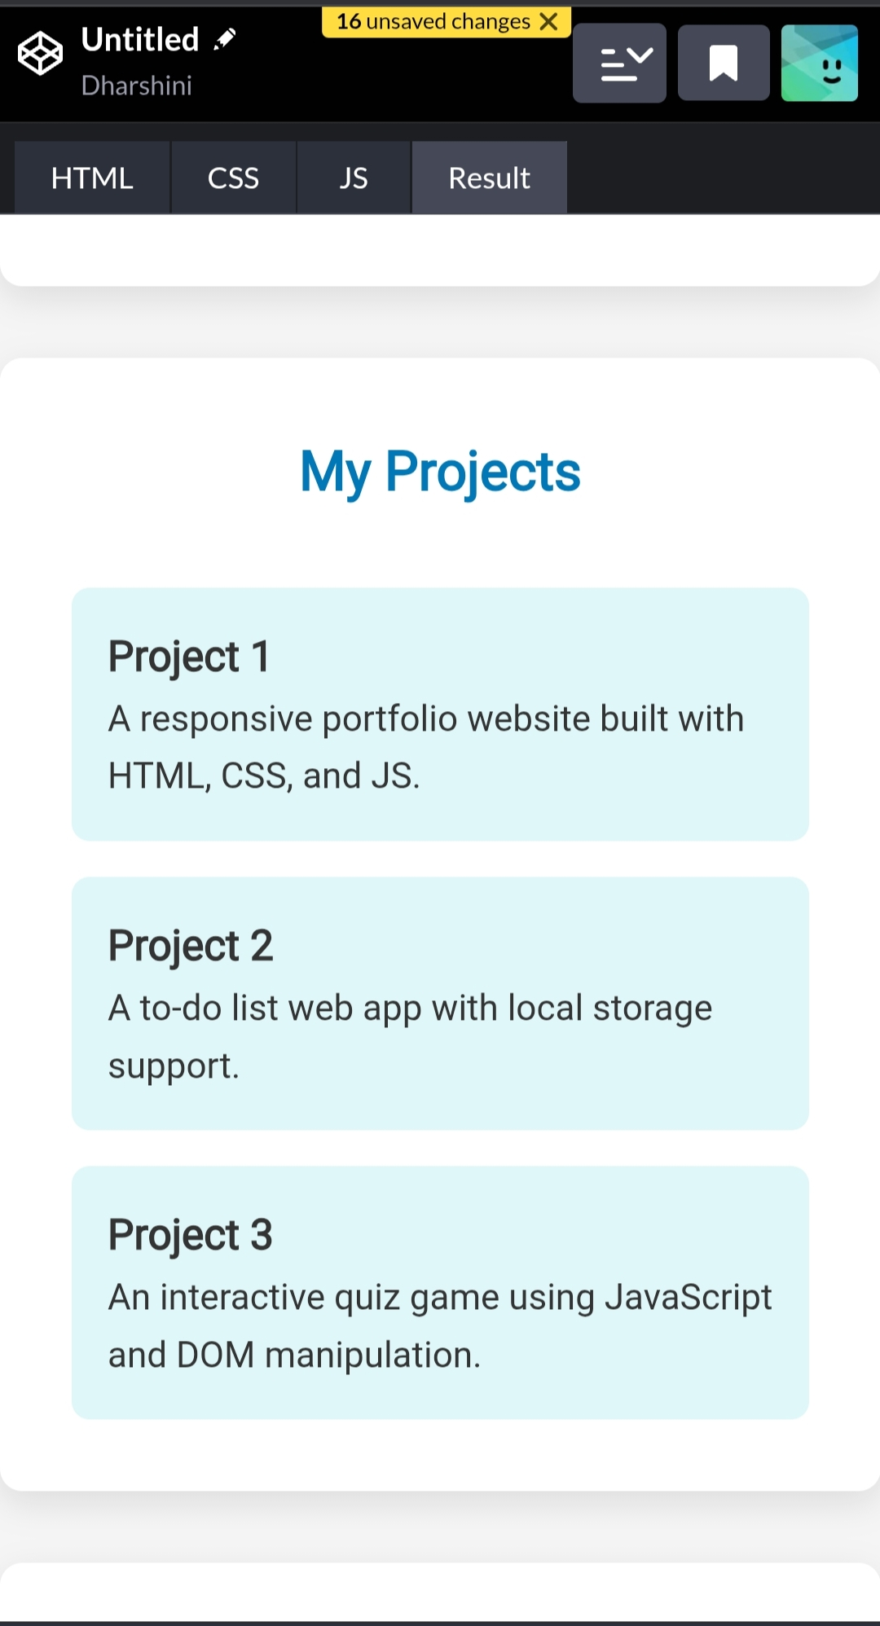
RESULTS AND SCREENSHOTS

Slide 11
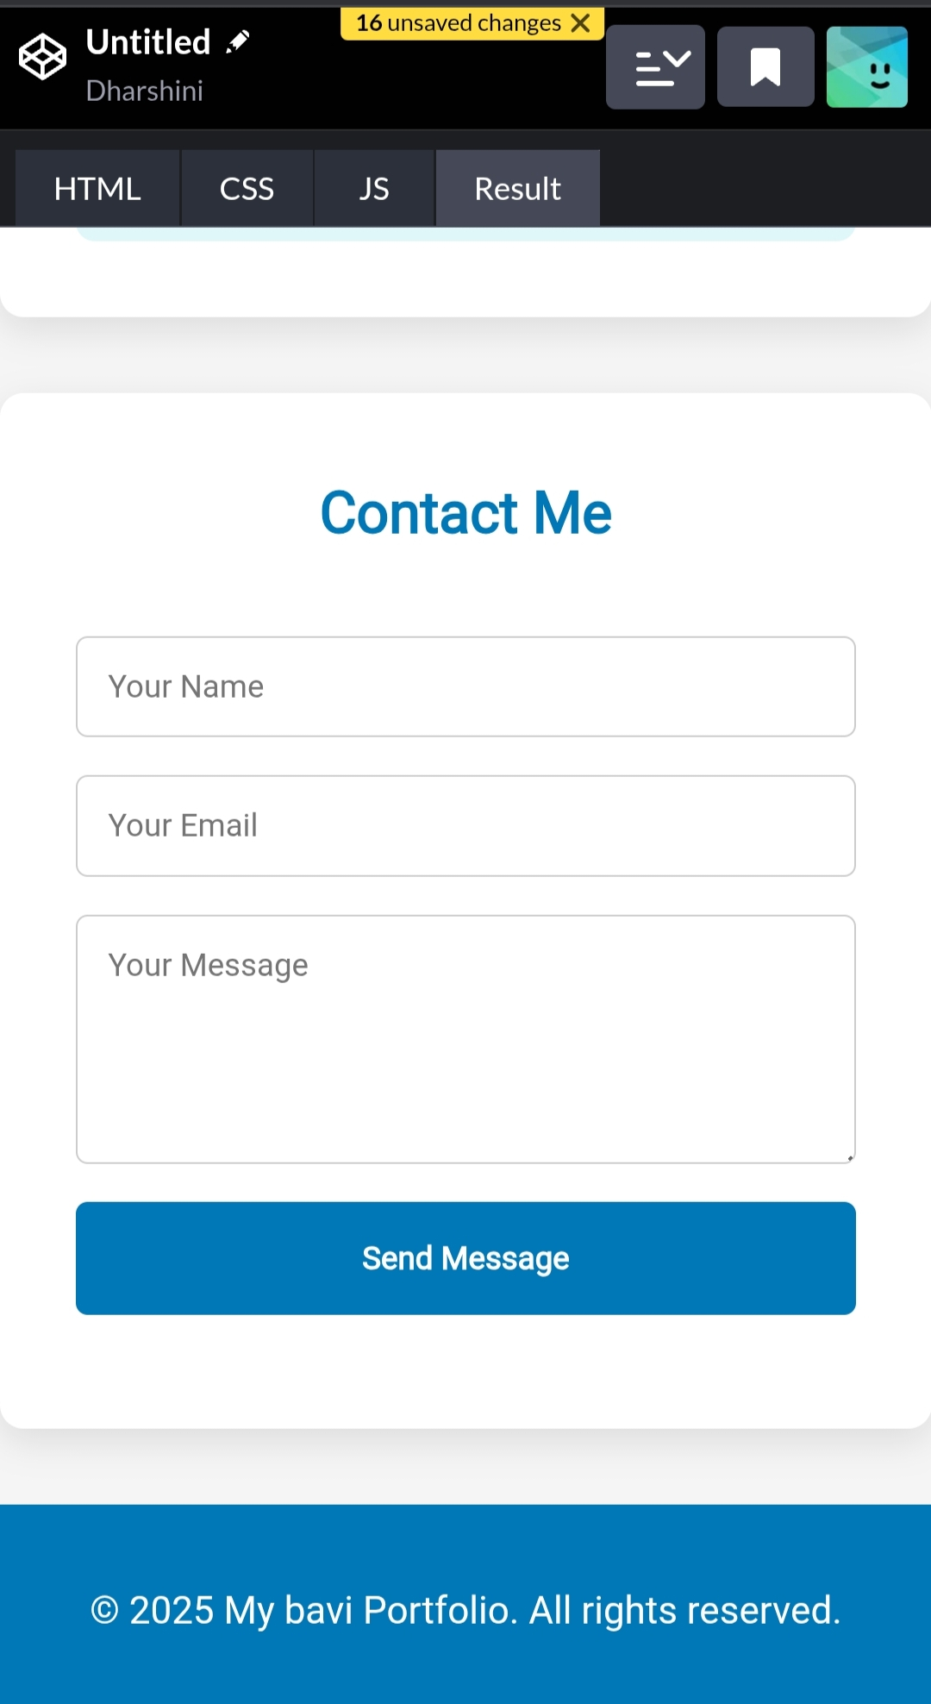

Slide 12
CONCLUSION
This portfolio website successfully showcases personal skills, projects, and contact details in a simple and interactive way. It provides a professional online presence, helping to connect with potential employers, clients, and collaborators. The responsive design ensures accessibility across devices, making it an effective tool for personal branding

